Slide 1




Spotlight on Ofgem's AI regulatory approach
Enabling responsible AI innovation while protecting consumers and energy system resilience
Jonathan Thurlwell
Head of Emerging Technologies
Ofgem
22 September 2026

Slide 2

Why is AI different?
“[A] computer systems which can perform tasks usually requiring human intelligence” (UK’s National Cyber Security Centre)
Doesn’t use clear rules or logic, is context dependent, and creates complex operational challenges
Can be used to provide advanced capabilities such as:
Prediction
Optimisation
Automation
Is incredibly difficult to test, due to its nature
AI:
Notes:
Speaking notes:
Key point: AI solves problems that would otherwise require human intelligence.
Relevant points (remove as necessary):
The term ‘Artificial Intelligence’ is old, created in 1956 at the “Dartmouth Workshop”
It includes many things, such as advanced analytics, machine learning

Slide 3




Why AI matters for energy regulation
Predict, optimise, automate
Consumers
  Customer service
  Process automation
  Vulnerable consumer identification
System operation
  Forecasting
  Energy dispatch
  Resilience analysis
Networks
  Asset management
  Maintenance planning
  Local flexibility markets
Markets
  Market forecasting
  Commodity pricing
  Trading execution
Powered by: AI, agentic and autonomous systems, robotics, drones

Slide 4
Ofgem’s AI regulatory approach
Regulatory stance:
Proportionate and risk‑based
Pro‑innovation
Outcomes‑focused
Principles-based
Sector and technology engagement
Key regulatory initiatives:
Ethical AI guidance
AI Reg Lab
AI technical sandbox
AI assurance
Risk monitoring and intelligence
Evidence
Guidance
AI Reg Lab
Strategy
AI Technical Sandbox
AI Assurance
Autumn 23
Autumn 26
Our regulatory approach continues to evolve to keep pace with AI technology

Slide 5
Our regulatory tools
Sandboxes enable Ofgem to gather evidence on AI use cases with regulatory implications and inform the sector
Ofgem’s AI Reg Lab:
Collaborative discussions exploring AI
Ofgem’s AI Technical Sandbox:
Digital environment for testing AI systems
Purpose
Brings Ofgem, industry and independent experts together to explore safe, secure, fair, sustainable and consumer-focused AI deployment
AI Reg Lab use cases
October 2025
Vulnerable consumer prioritisation
Improved infrastructure planning
February 2026
a: Legacy asset mapping
b: Digital twin creation
Purpose
A trusted, ethical and supervised digital environment to explore how AI systems perform in real-world conditions
Delivery model and milestones
1. Initial focus on limited number of high-value use cases
Further indicative milestones include targeting:
1. publication of participation guidance in Autumn 2026
2. opening of applications in late Autumn 2026
3. initial testing rounds commencing from early 2027
2. Supported through structured testing phases
3. Enabling intentional collaboration, iterative development,
early learning and a proportionate approach
Submissions open on a rolling basis
Enabling
Responsible innovation + growth
Collaborative risk identification
Shared sectoral learning
Consumer protection
Energy sector companies with their innovation partners
Who can participate?
Notes:
Tech Sandbox
What it enables: selected energy sector licensees and innovation partners to test high-value AI use cases through structured, phased testing.
What Ofgem learns: Practical evidence on AI performance, safeguards, risks and regulatory barriers.
Reg Lab
What it enables: Supports early discussion of hypothetical and real-world AI use cases, including opportunities, risks, governance questions and consumer impacts.
What Ofgem learns: Builds insight into how AI is being developed and deployed across the sector, helping inform proportionate regulation and future guidance.

Slide 6
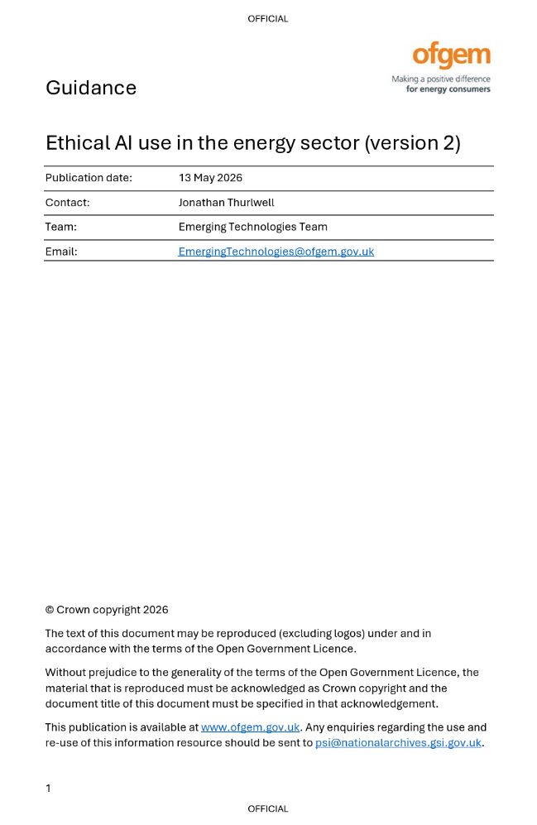
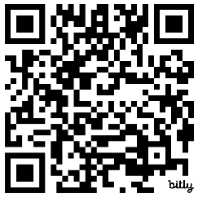
What the future holds
Building trust in AI
Enabling responsible innovation
Preparing for what’s next
AI assurance evidence review
Continue to facilitate AI Reg Labs
AI technical sandbox development and pilot
AI guidance version 3
Further development of horizon scanning capabilities
Emerging technologies beyond AI
AI assurance consultation
Scan me

Slide 7
Thank you
EmergingTechnologies@ofgem.gov.uk

Slide 8
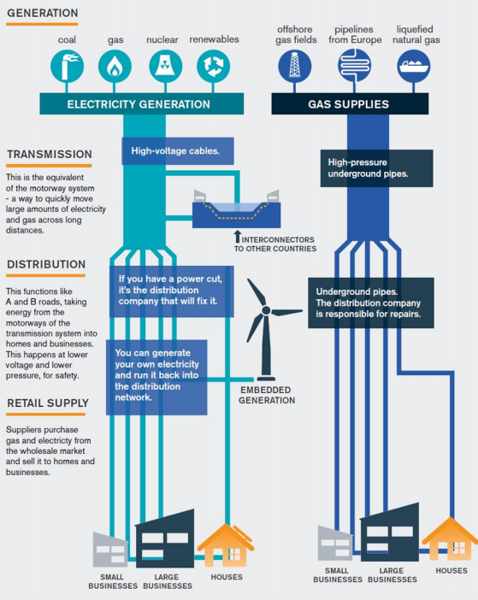
The role of Ofgem
Office of Gas and Electricity Markets
Who we are
What we do
Our vision and mission
Great Britain’s energy regulator (gas and electricity)
We work with government, industry and consumer groups
Set and enforce the rules for energy companies
Issue licences and regulate how energy is produced, transported and sold
Monitor performance and act when standards are not met
Vision: A trusted and fair energy system that works for consumers and the country
Independent, non-ministerial government department
Mission: Protecting consumers, supporting net zero and enabling
growth across the economy
Our evolving role
Our core duties are
Consumer protection
Economic growth
Net zero transition

Slide 9
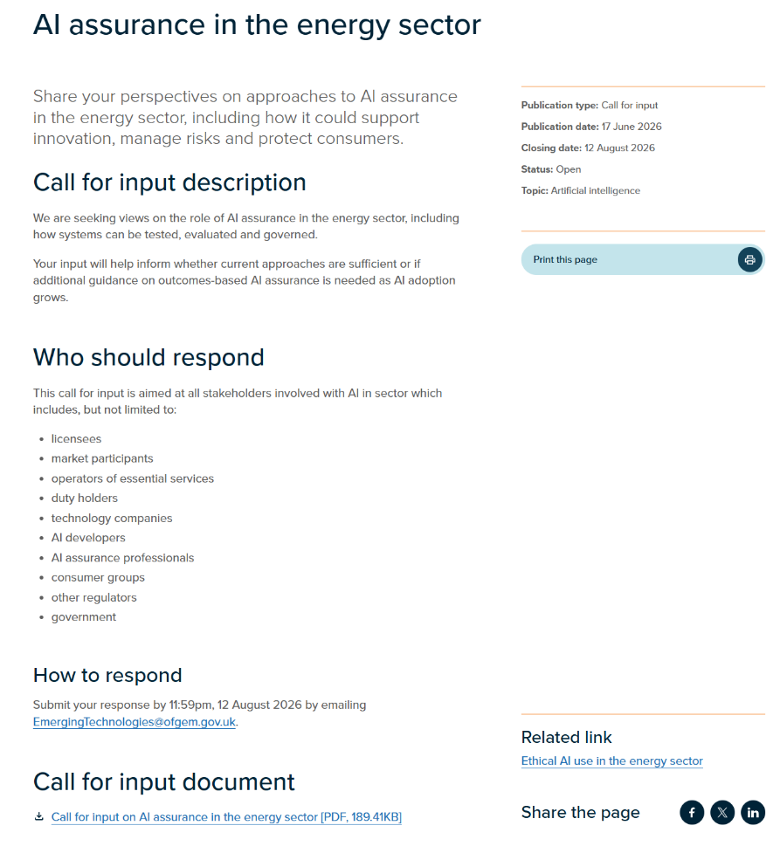
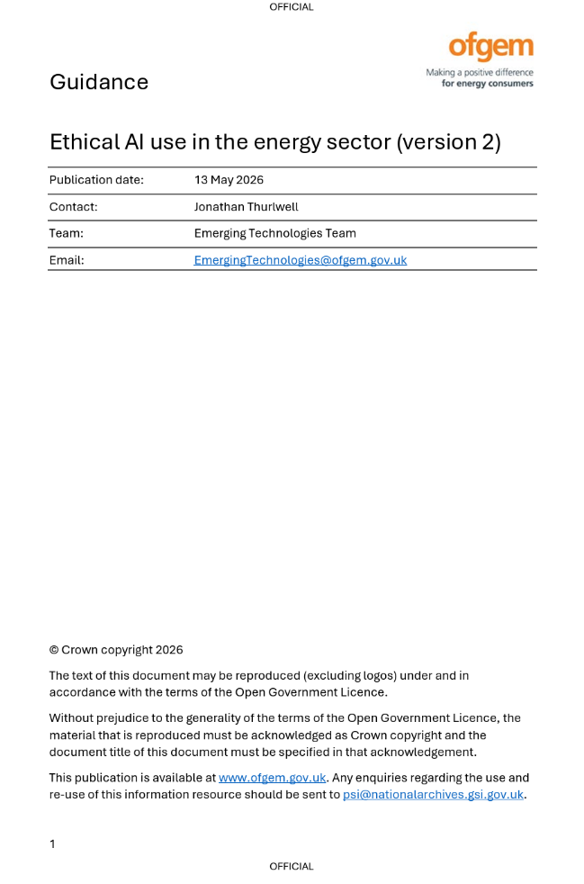


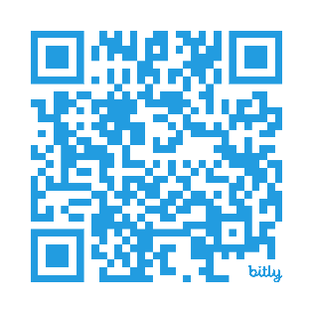
Access our work
Scan me
Scan me

Slide 10

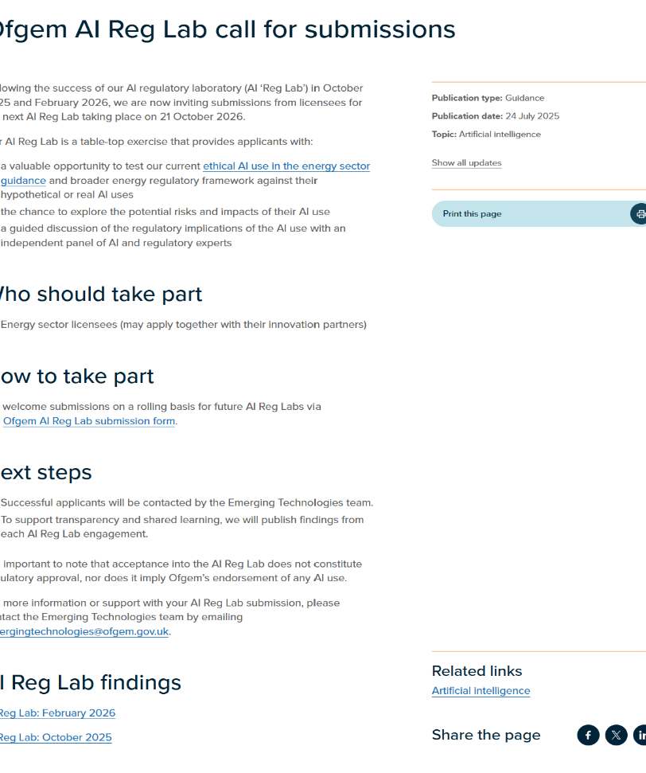
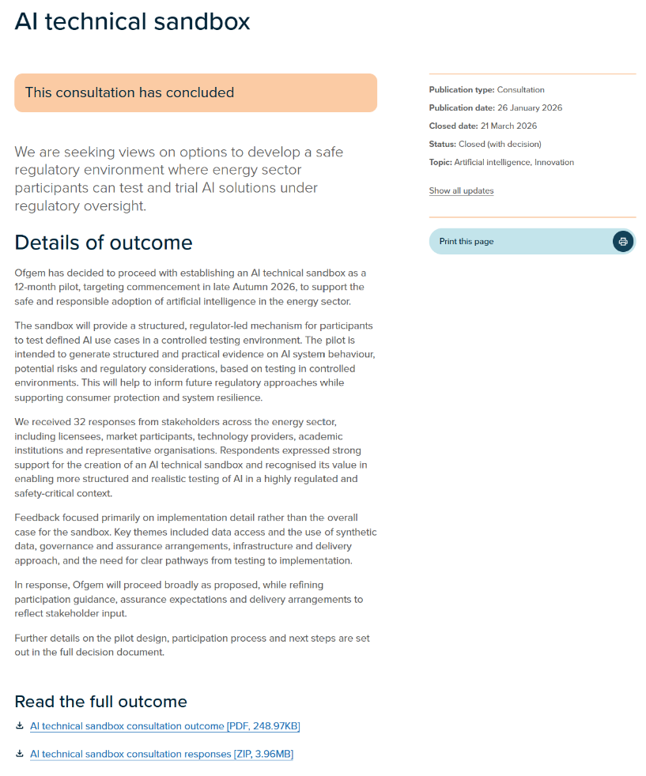
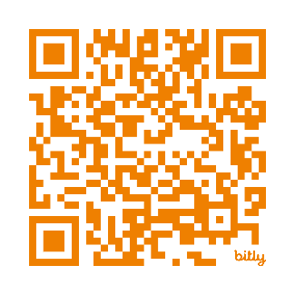
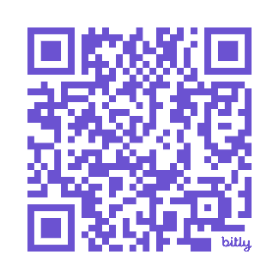
Access our work
Scan me
Scan me

